Slide 1
Chapter 17 Alcohols and Phenols

Slide 2
Learning Objectives
(17.1)
Naming alcohols and phenols
(17.2)
Properties of alcohols and phenols
(17.3)
Preparation of alcohols: A review
(17.4)
Alcohols from carbonyl compounds: Reduction

Slide 3
Learning Objectives
(17.5)
Alcohols from carbonyl compounds: Grignard reaction
(17.6)
Reactions of alcohols
(17.7)
Oxidation of alcohols
(17.8)
Protection of alcohols

Slide 4
Learning Objectives
(17.9)
Phenols and their uses
(17.10)
Reactions of phenols
(17.11)
Spectroscopy of alcohols and phenols

Slide 5
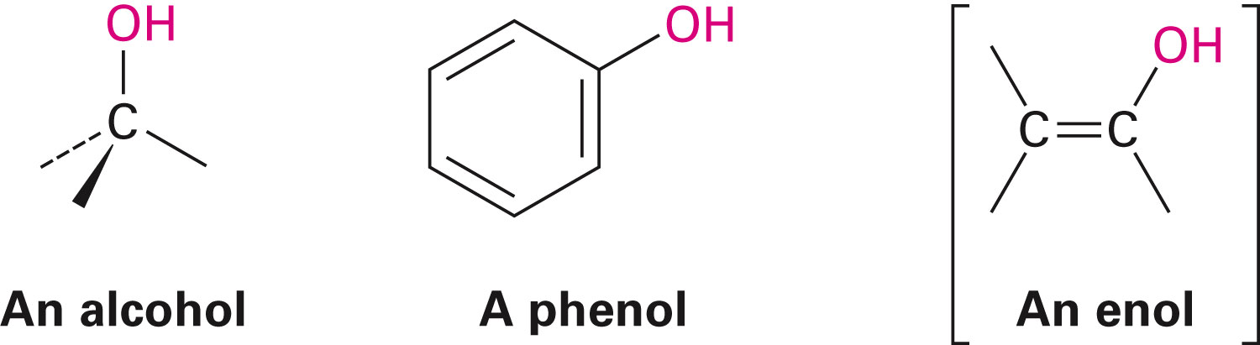
Alcohols and Phenols
Organic derivatives of water
One of water’s hydrogens is replaced by an organic group
Alcohols contain an –OH group connected to a saturated, sp³-hybridized C atom

Slide 6
Alcohols and Phenols
Important solvents and synthesis intermediates
Phenols contain an OH group connected to a carbon in a benzene ring
Ethanol, CH₃CH₂OH, called ethyl alcohol, is a solvent, fuel, and beverage
Phenol has diverse uses and gives its name to the general class of compounds

Slide 7
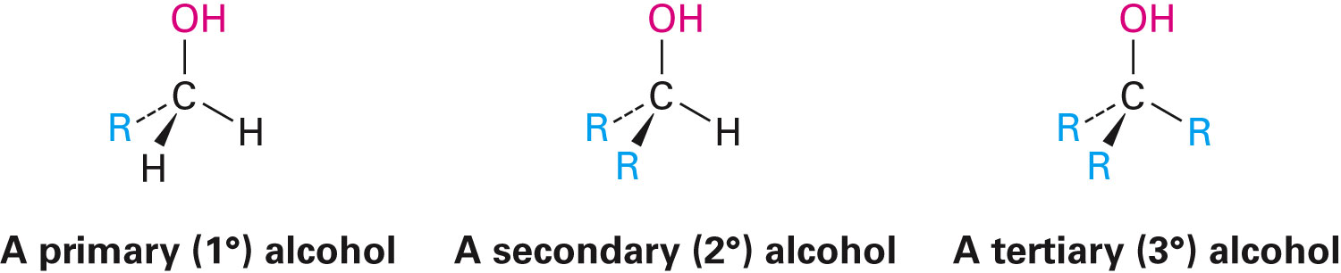
Naming Alcohols and Phenols
General classifications of alcohols are based on number of organic groups bonded to the hydroxyl-bearing carbon
IUPAC system names simple alcohols as derivatives of the parent alkane with a suffix -ol
Notes:
Naming alcohols and phenols

Slide 8
Naming Alcohols
Rule 1
Select the longest carbon chain containing the hydroxyl group, and derive the parent name by replacing the -e ending of the corresponding alkane with -ol
Rule 2
Number the chain from the end nearer the hydroxyl group
Notes:
Naming alcohols and phenols

Slide 9
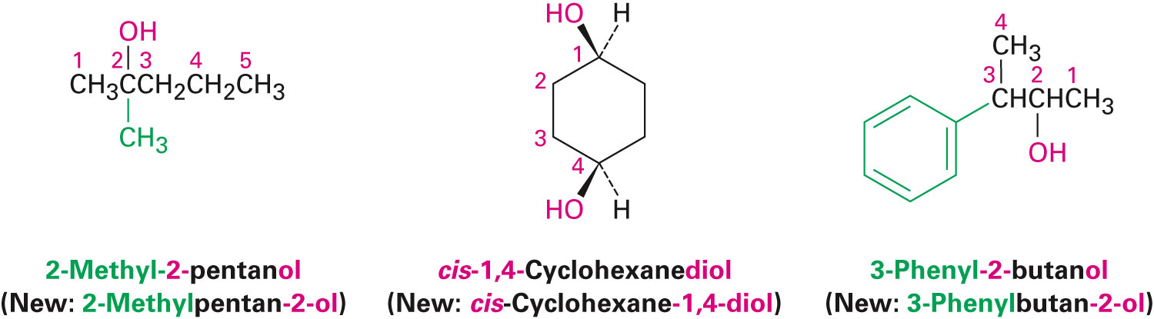
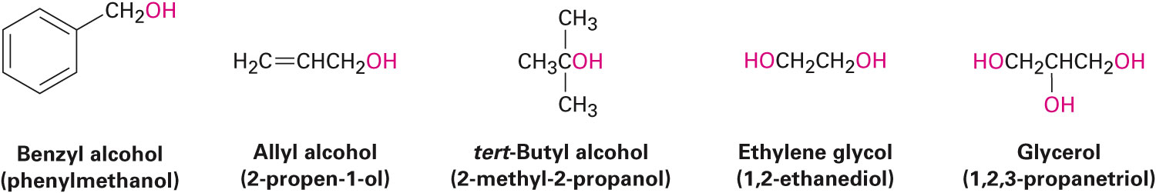
Naming Alcohols
Rule 3
Number substituents according to position on chain, listing the substituents in alphabetical order
Notes:
Naming alcohols and phenols

Slide 10
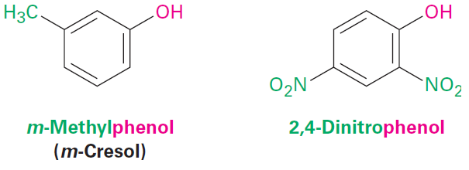
Naming Phenols
-phenol is used as the parent name
Not -benzene
Name substituents on aromatic ring by their position from –OH
Notes:
Naming alcohols and phenols

Slide 11
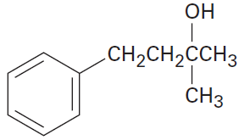
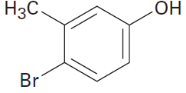
Worked Example
Give IUPAC names for the following compounds
a) b)
Solution:
The parent chain must contain the hydroxyl group
The hydroxyl group should receive the lowest possible number
a) 2-Methyl-4-phenyl-2-butanol
b) 4-Bromo-3-methylphenol
Notes:
Naming alcohols and phenols

Slide 12
Properties of Alcohols and Phenols
Structure around O of alcohols or phenols are similar to that in water, sp³-hybridized
Attraction of positively polarized –OH hydrogen atom from one molecule to the lone pair of electrons on a negatively polarized oxygen atom of another molecule:
Produces weak force that holds the molecules together
Raises the boiling temperature
Notes:
Properties of alcohols and phenols

Slide 13
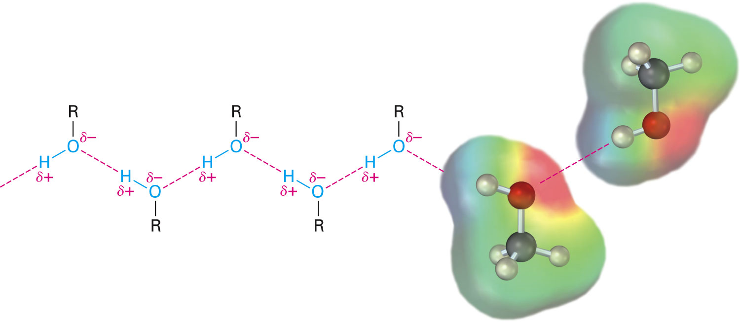
Figure 17.1 - Hydrogenbonding in Alcohols and Phenols
Notes:
Properties of alcohols and phenols

Slide 14
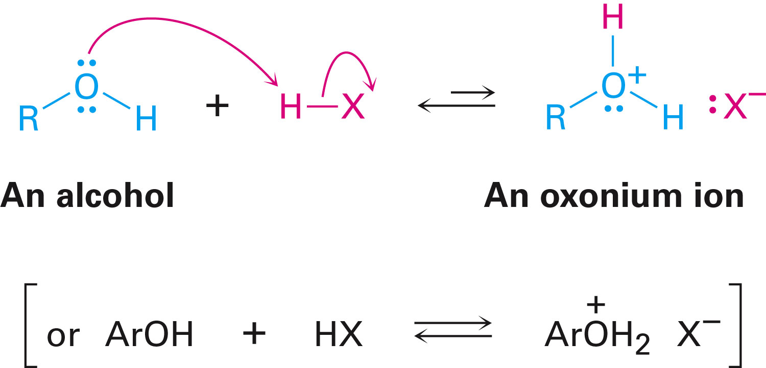
Properties of Alcohols and Phenols
Weakly basic and weakly acidic
Weak bases, protonated by strong acids yield oxonium ions, ROH₂⁺
Notes:
Properties of alcohols and phenols

Slide 15
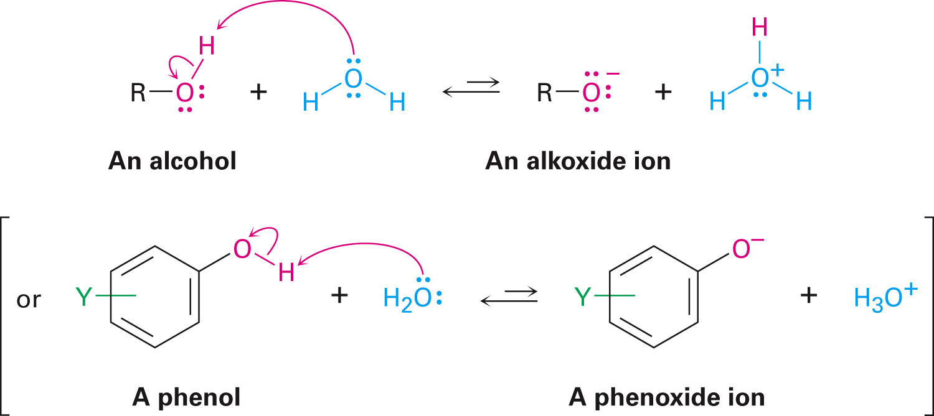
Properties of Alcohols and Phenols
Weak acids, dissociate slightly in dilute aqueous solution generating H₃O⁺ and an alkoxide ion, RO⁻ or phenoxide ion, ArO⁻
Notes:
Properties of alcohols and phenols

Slide 16
Properties of Alcohols and Phenols
Strength of an acid in water can be expressed by an acidity constant, K_{a}
Smaller K_{a} and larger pK_{a}, less acidic
Larger K_{a} and smaller pK_{a}, more acidic
Effect of alkyl substitution on alcohol acidity is primarily due to solvation of alkoxide ion formed on acid dissociation
Notes:
Properties of alcohols and phenols

Slide 17
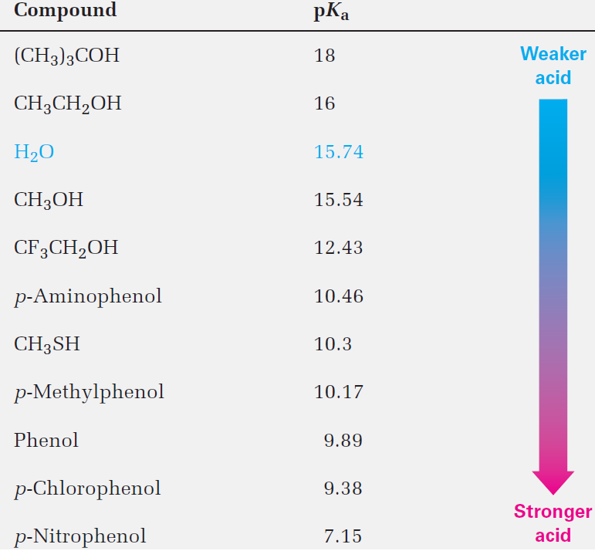
Table 17.1 - Acidity Constants of Some Alcohols and Phenols
Notes:
Properties of alcohols and phenols

Slide 18
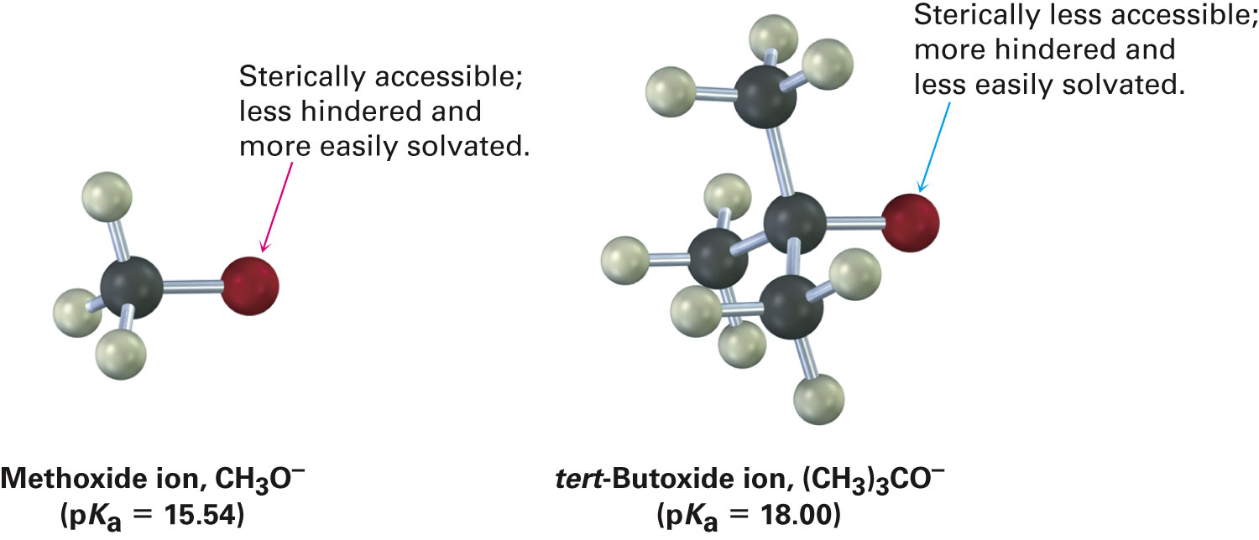
Properties of Alcohols and Phenols
The more easily the alkoxide ion is solvated by water, the more its formation is energetically favored
Inductive effects are important in determining alcohol acidities
Notes:
Properties of alcohols and phenols

Slide 19
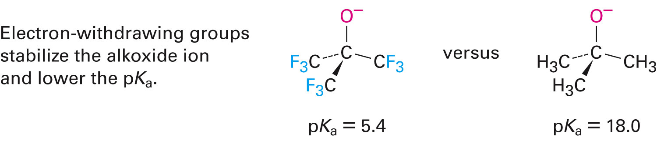
Properties of Alcohols and Phenols
Electron-withdrawing groups make an alcohol a stronger acid by stabilizing the conjugate base
Alcohols react with alkali metals and with strong bases
Notes:
Properties of alcohols and phenols

Slide 20
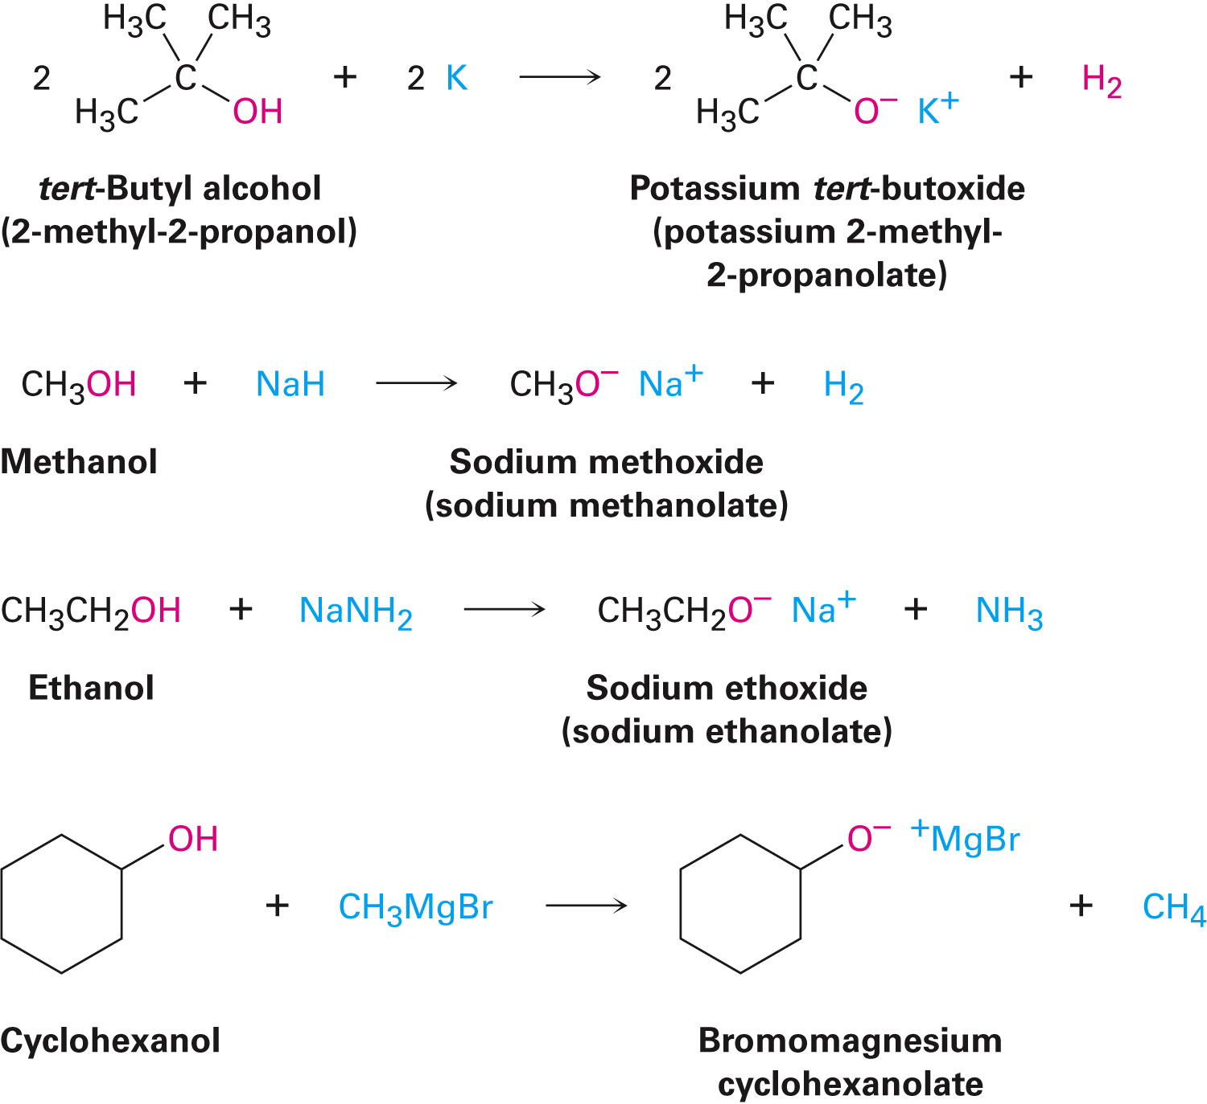
Properties of Alcohols and Phenols
Alkoxides are bases used as reagents in organic chemistry
Notes:
Properties of alcohols and phenols

Slide 21
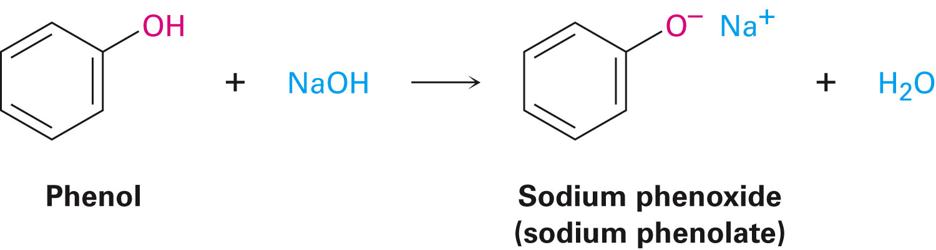
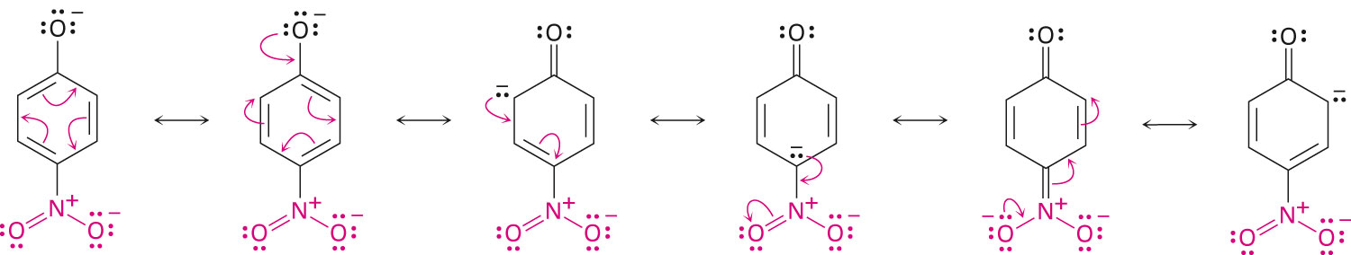
Properties of Alcohols and Phenols
Phenols are more acidic than alcohols due to resonance stabilization of the phenoxide ion
Phenols with an electron-withdrawing substituent are more acidic and phenols with an electron-donating substituent are less acidic
Notes:
Properties of alcohols and phenols

Slide 22
Worked Example
Rank the following substances in order of increasing acidity
a) (CH₃)₂CHOH, HC≡CH, (CF₃)₂CHOH, CH₃OH
b) Benzyl alcohol, phenol, p-hydroxybenzoic acid
Solution:
Least acidic Most acidic
a) HC≡CH < (CH₃)₂CHOH < CH₃OH < (CF₃)₂CHOH
b) Benzyl alcohol < phenol < p-hydroxybenzoic acid
Notes:
Properties of alcohols and phenols

Slide 23
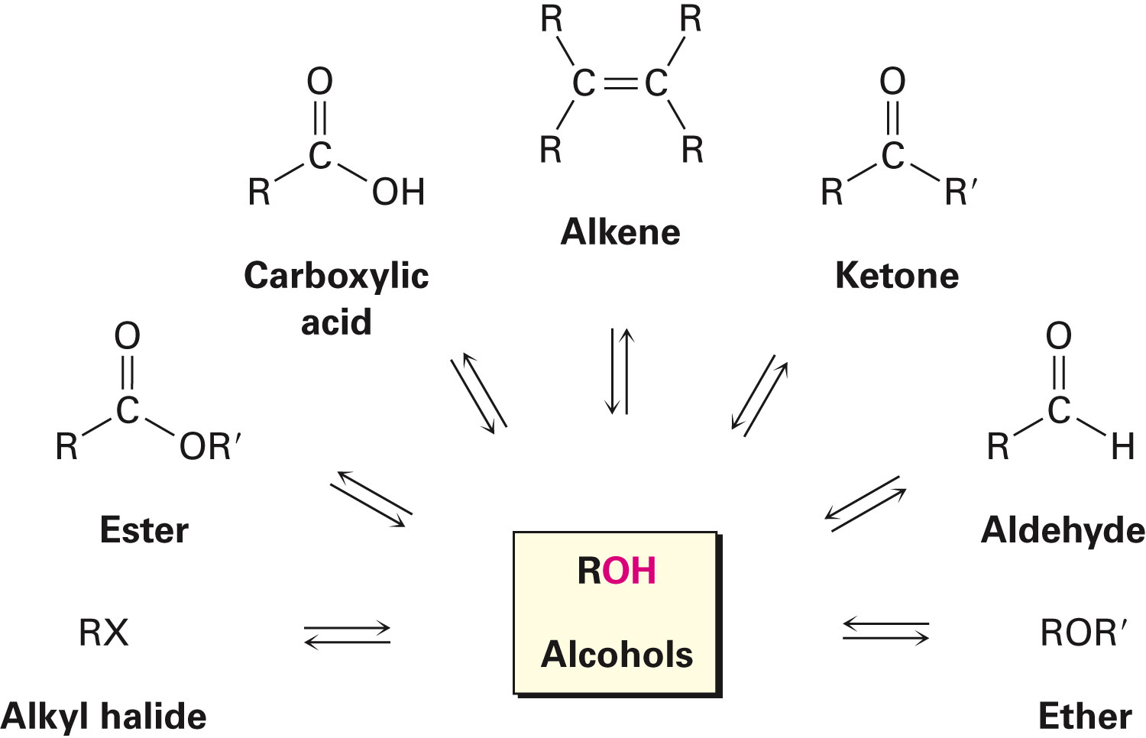
Preparation of Alcohols: A Review
Alcohols are derived from many types of compounds
The alcohol hydroxyl can be converted to many other functional groups
Notes:
Preparation of alcohols: A review

Slide 24
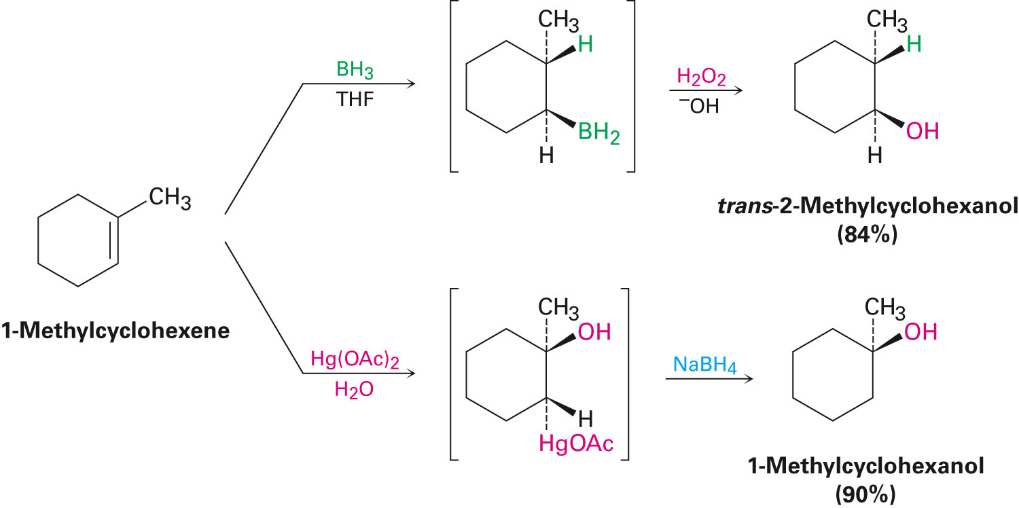
Preparation of Alcohols: A Review
In the hydroboration of alkenes, indirect methods used are:
Hydroboration-oxidation, yielding the syn, non-Markovnikov hydration product
Oxymercuration-demercuration yielding Markovnikov hydration product
Notes:
Preparation of alcohols: A review

Slide 25
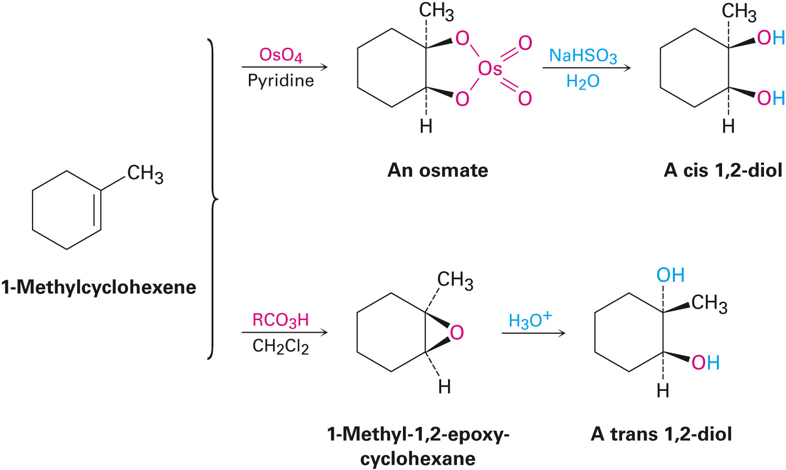
Preparation of Alcohols: A Review
Cis-1,2-diols are prepared from direct hydroxylation of an alkene with OsO₄ followed by reduction with NaHSO₃
Trans-1,2-diols can be prepared from acid-catalyzed hydrolysis of epoxides
Notes:
Preparation of alcohols: A review

Slide 26
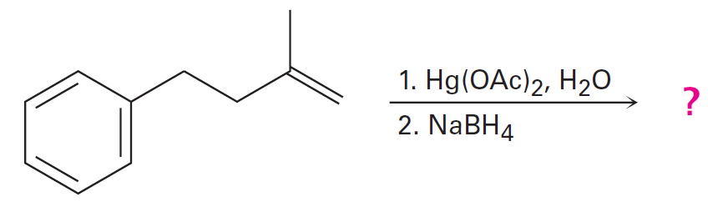
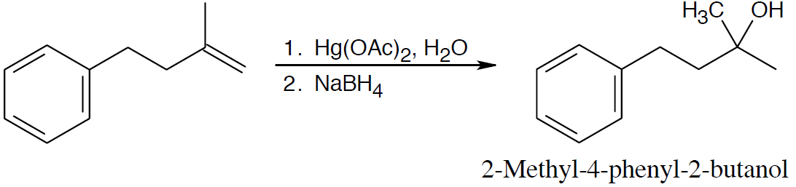
Worked Example
Predict the products of the following reaction
Solution:
Markovnikov product results from oxymercuration/reduction
Notes:
Preparation of alcohols: A review

Slide 27
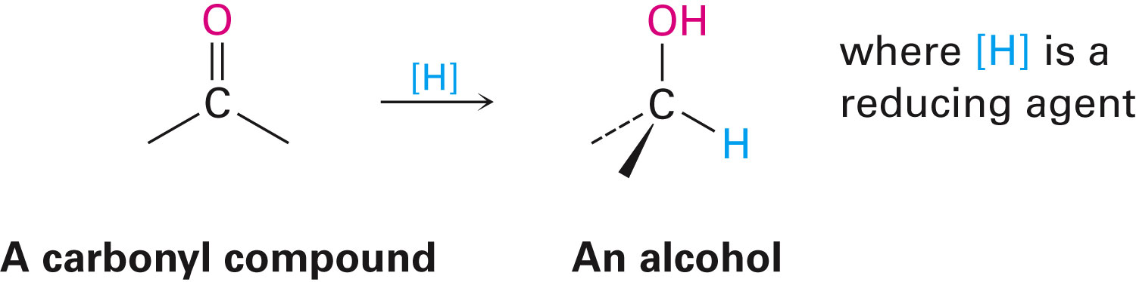
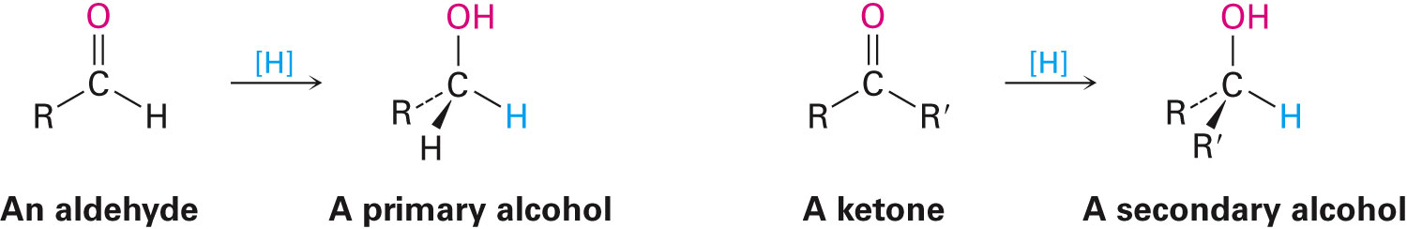
Alcohols from Carbonyl Compounds: Reduction
Reduction of a carbonyl compound gives an alcohol
Addition of H to a C═O bond
Reduction of aldehydes gives primary alcohols
Reduction of ketones gives secondary alcohols
Notes:
Alcohols from carbonyl compounds: Reduction

Slide 28
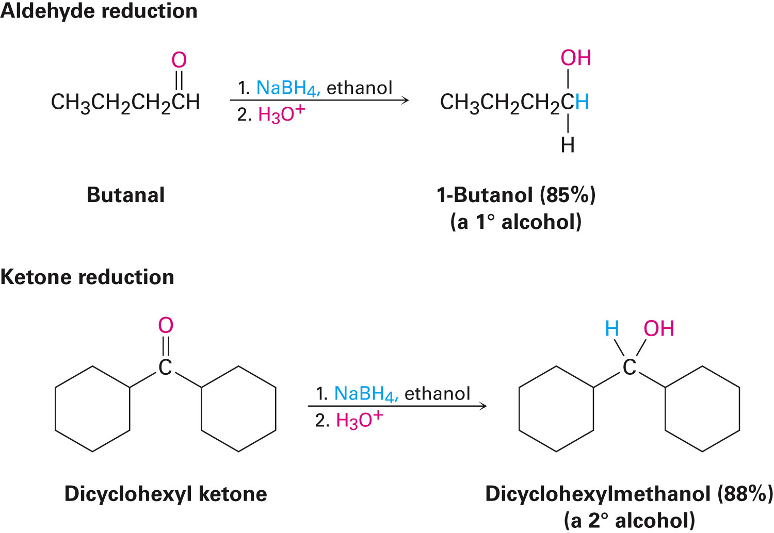
Reduction Reagent: Sodium Borohydride (NaBH₄)
NaBH₄ is not sensitive to moisture and can be used with either water or alcohol
Notes:
Alcohols from carbonyl compounds: Reduction

Slide 29
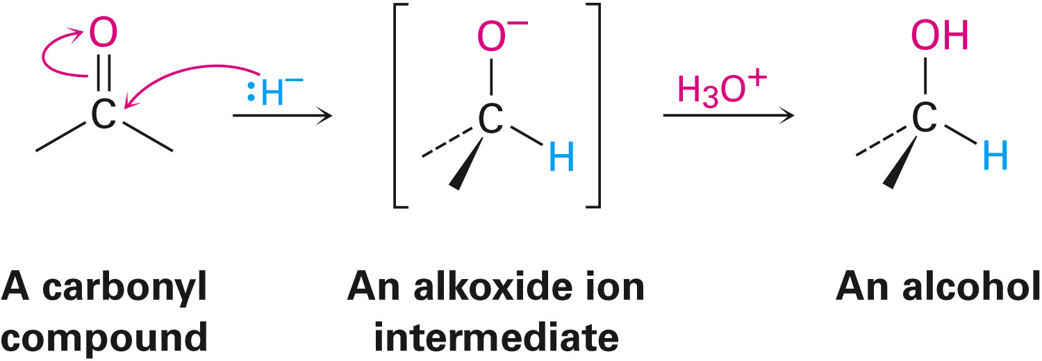
Mechanism of Reduction
Addition of a nucleophilic hydride ion to the positively polarized, electrophilic carbon atom of the carbonyl group
Alkoxide ion is protonated to yield the alcohol product
Notes:
Alcohols from carbonyl compounds: Reduction

Slide 30
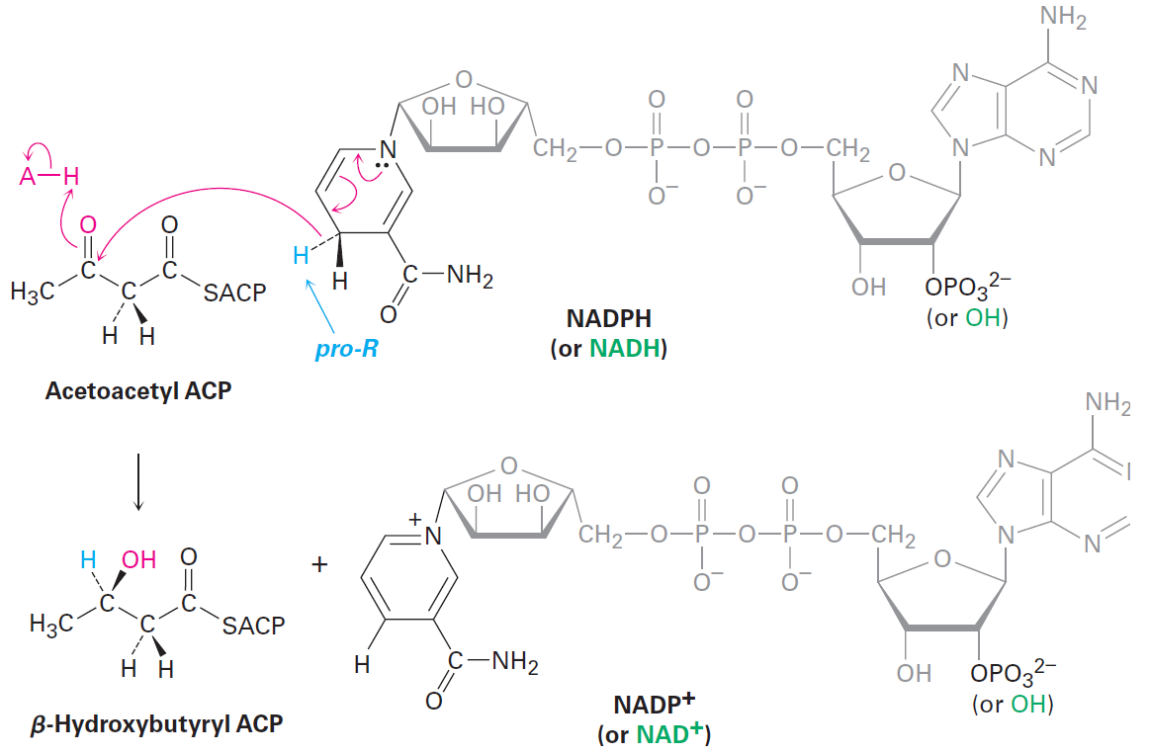
Reductions in Living Organisms
Carried out by either of the coenzymes, NADH or NADPH
Notes:
Alcohols from carbonyl compounds: Reduction

Slide 31
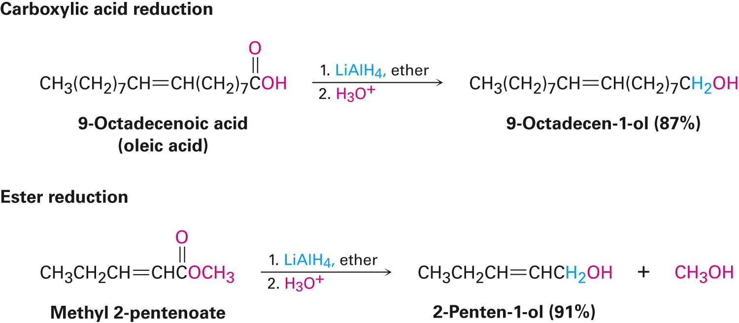
Reduction of Carboxylic Acids and Esters
Carboxylic acids and esters are reduced to give primary alcohols
LiAlH₄ is used because NaBH₄ is not effective
Notes:
Alcohols from carbonyl compounds: Reduction

Slide 32
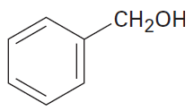
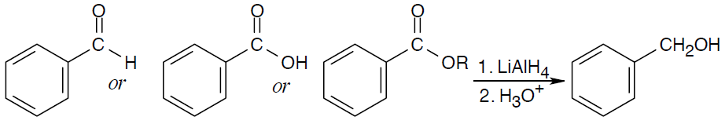
Worked Example
What carbonyl compounds give the following alcohol on reduction with LiAlH₄?
Solution:
Benzyl alcohol may be the reduction product of an aldehyde, a carboxylic acid, or an ester
Notes:
Alcohols from carbonyl compounds: Reduction

Slide 33
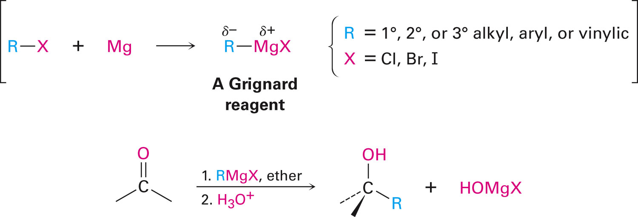
Alcohols from Carbonyl Compounds: Grignard Reagents
Organohalides react with magnesium to produce Grignard reagents, RMgX
Grignard reagents react with carbonyl compounds to yield alcohols
Notes:
Alcohols from carbonyl compounds: Grignard reaction

Slide 34
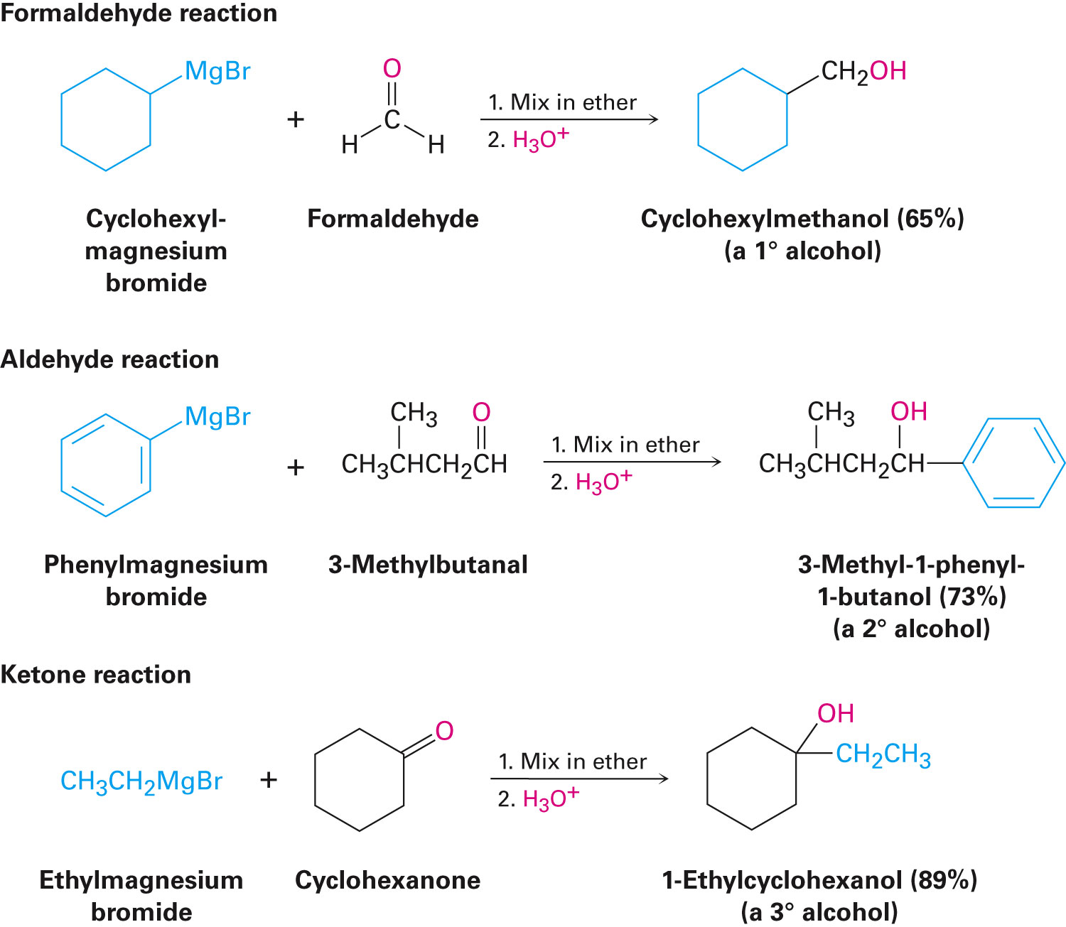
Alcohols from Carbonyl Compounds: Grignard Reagents
Notes:
Alcohols from carbonyl compounds: Grignard reaction

Slide 35
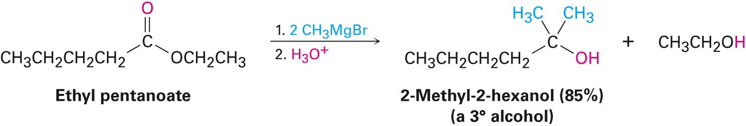
Alcohols from Carbonyl Compounds: Grignard Reagents
Esters react with Grignard reagents to yield tertiary alcohols
Grignard reagents do not give addition products with carboxylic acids
Acidic carboxyl hydrogen reacts with the basic Grignard reagent to yield a hydrocarbon and the magnesium salt of the acid
Notes:
Alcohols from carbonyl compounds: Grignard reaction

Slide 36
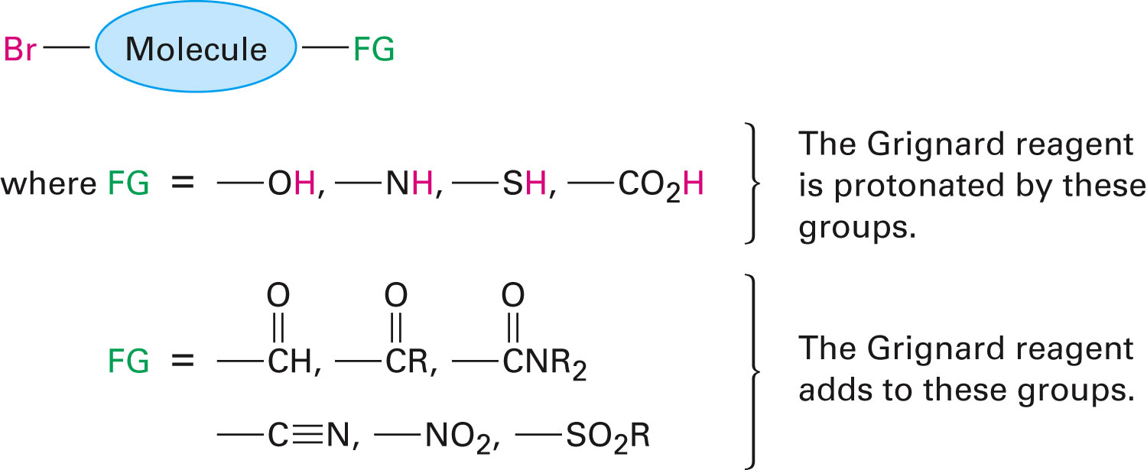
Limitations of Grignard Reagents
If other reactive functional groups are present in the same molecule, Grignard reagent cannot be prepared from an organohalide
Notes:
Alcohols from carbonyl compounds: Grignard reaction

Slide 37
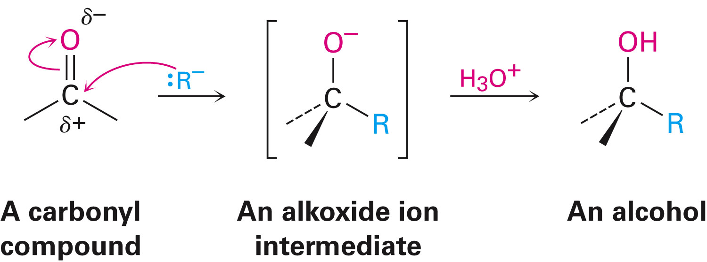
Mechanism of the Addition of a Grignard Reagent
Grignard reagents act as nucleophilic carbon anions
Intermediate alkoxide is protonated to produce the alcohol
Notes:
Alcohols from carbonyl compounds: Grignard reaction

Slide 38
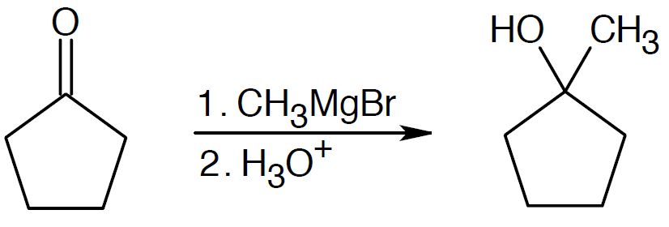
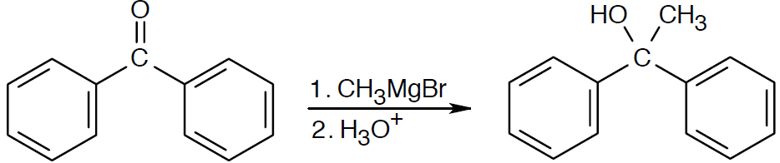
Worked Example
Show the products obtained from addition of methylmagnesium bromide to the following compounds
a) Cyclopentanone
b) Benzophenone
Solution:
a)
b)
Notes:
Alcohols from carbonyl compounds: Grignard reaction

Slide 39
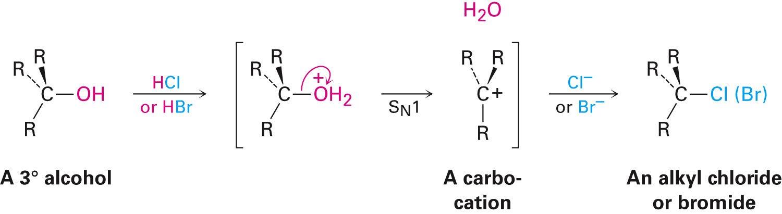
Reactions of Alcohols
Conversion of alcohols into alkyl halides
3˚ alcohols react with HCl or HBr by S_{N}1 through carbocation intermediate
1˚ and 2˚ alcohols are converted into halides by treatment with SOCl₂ or PBr₃ via S_{N}2 mechanism
Notes:
Reactions of alcohols

Slide 40
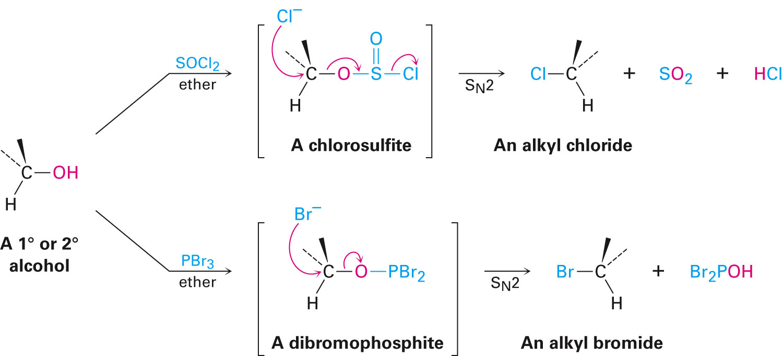
Reactions of 1˚ and 2˚ Alcohols
Notes:
Reactions of alcohols

Slide 41
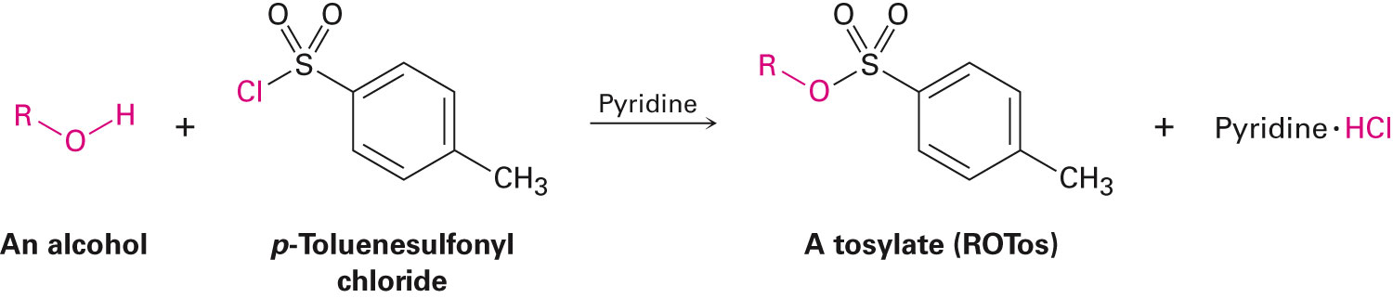
Conversion of Alcohols into Tosylates
Reaction of alcohols with p-toluenesulfonyl chloride in pyridine yields alkyl tosylates, ROTos
C–O bond remains intact and configuration at a chirality center is maintained
Resulting alkyl tosylates react like alkyl halides
Notes:
Reactions of alcohols

Slide 42
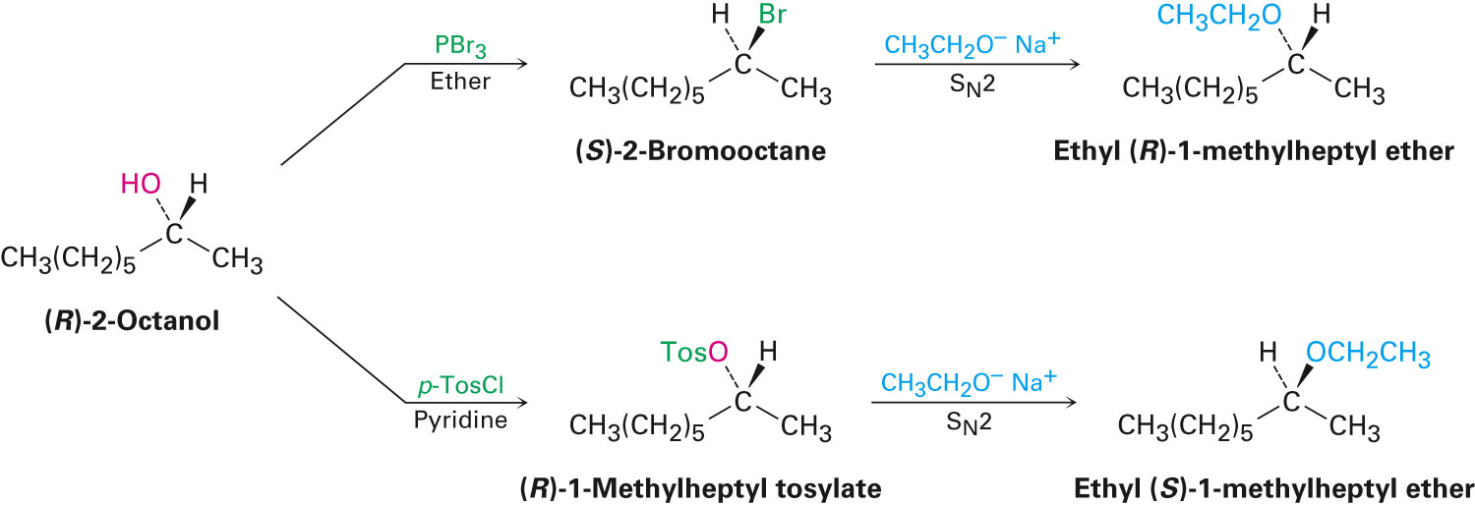
Stereochemical Uses of Tosylates
The S_{N}2 reaction of an alcohol via an alkyl halide proceeds with two inversions, giving a product with same arrangement as the starting alcohol
The S_{N}2 reaction of an alcohol via a tosylate, produces inversion at the chirality center
Notes:
Reactions of alcohols

Slide 43
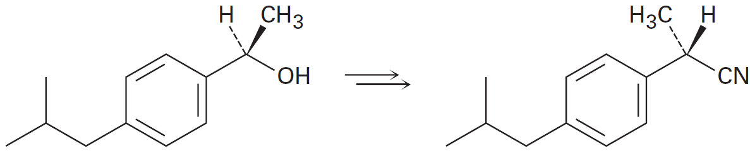
Worked Example
How can following transformation, a step used in the commercial synthesis of (S)-ibuprofen, be carried out?
Solution:
In conditions run under S_{N}2, –OH is a very poor leaving group
Notes:
Reactions of alcohols

Slide 44
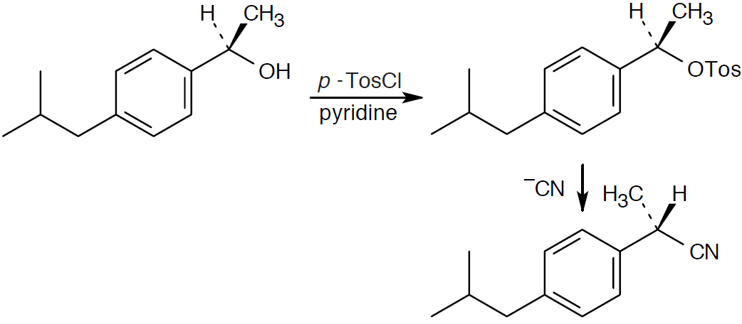
Worked Example
Toluenesulfonate of the alcohol proceeds readily to give the desired product with inversion of configuration at the chirality center
Notes:
Reactions of alcohols

Slide 45
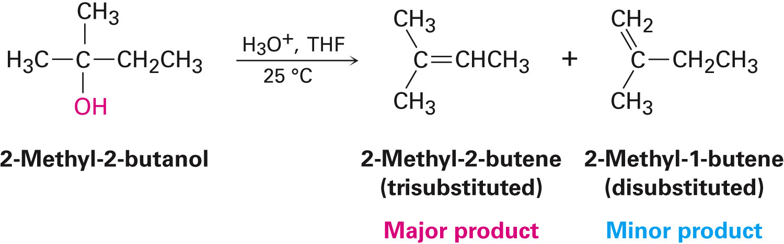
Dehydration of Alcohols to Yield Alkenes
Tertiary alcohols are dehydrated using acid-catalyzed reactions
Follows Zaitsev’s rule and yields a more stable alkene as the major product
Reactivity is the result of the nature of the carbocation intermediate
Notes:
Reactions of alcohols

Slide 46
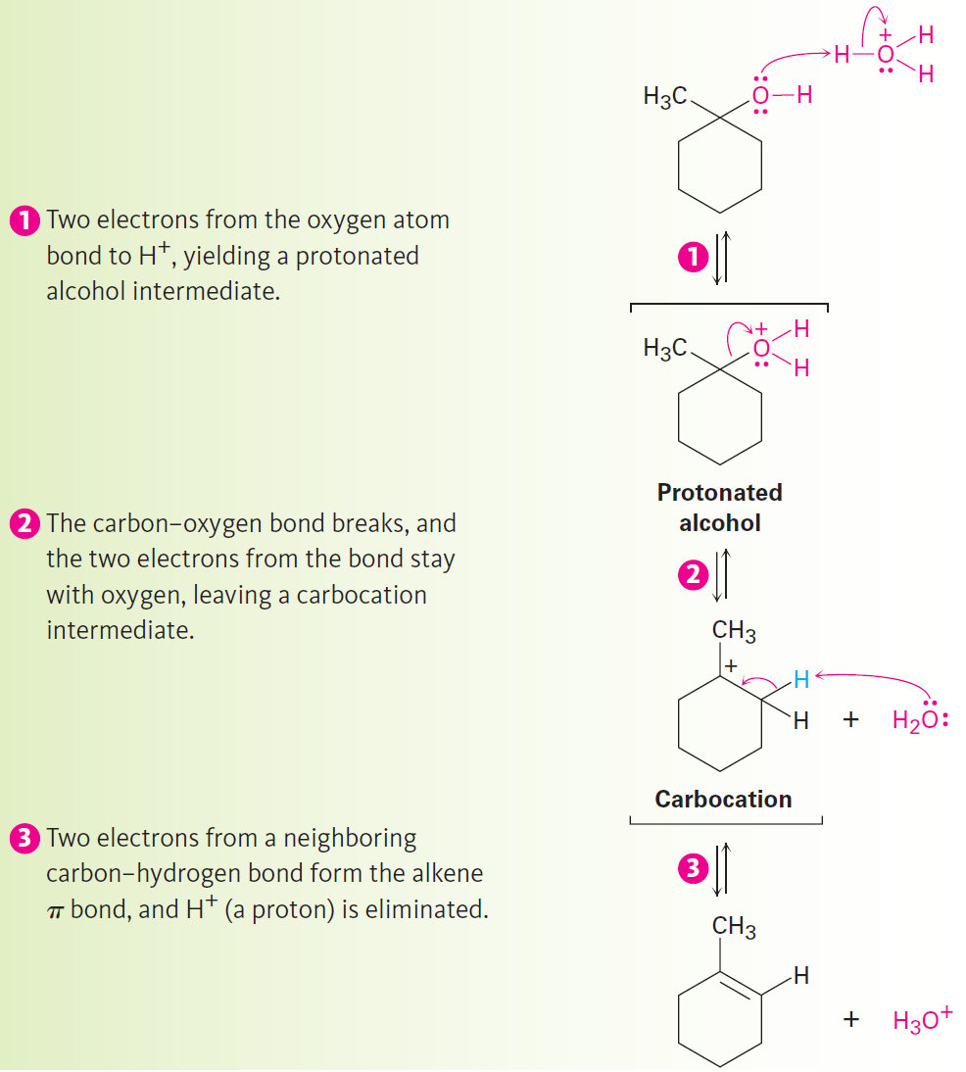
Figure 17.6 - Mechanism
Notes:
Reactions of alcohols

Slide 47
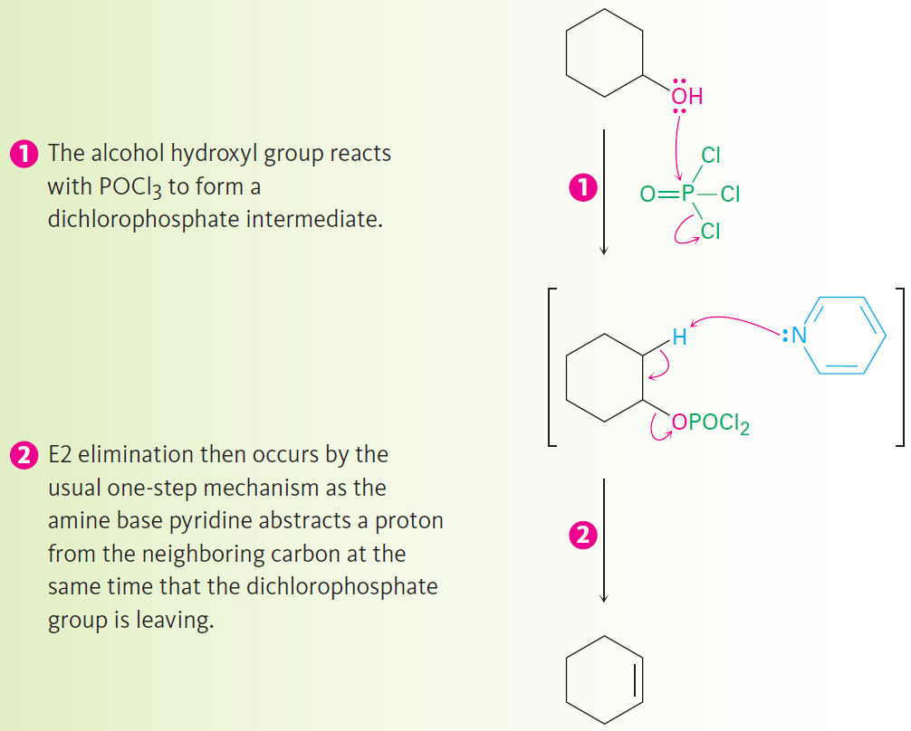
Dehydration with POCl₃
Direct E2 elimination of water does not occur because hydroxide ion is a poor leaving group
Notes:
Reactions of alcohols

Slide 48
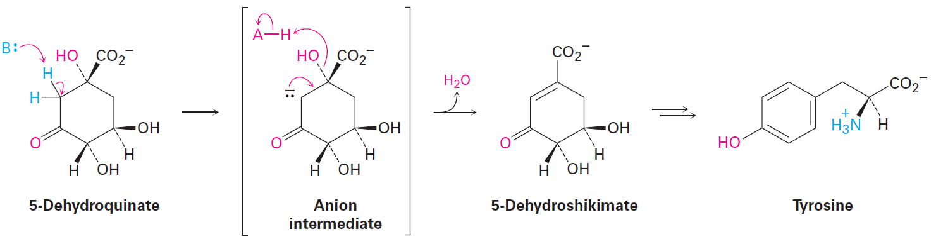
Biological Dehydrations
Common and occur by an E1cB mechanism
Example
Biosynthesis of the aromatic amino acid tyrosine
Notes:
Reactions of alcohols

Slide 49
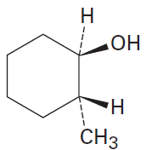
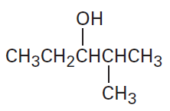
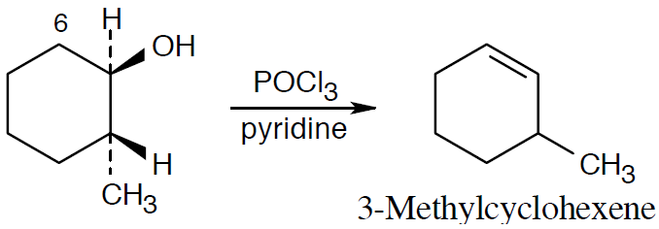
Worked Example
What product(s) are expected from dehydration of the following alcohols with POCl₃ in pyridine?
Indicate the major product in each case
a) b)
Solution:
a)
Notes:
Reactions of alcohols

Slide 50
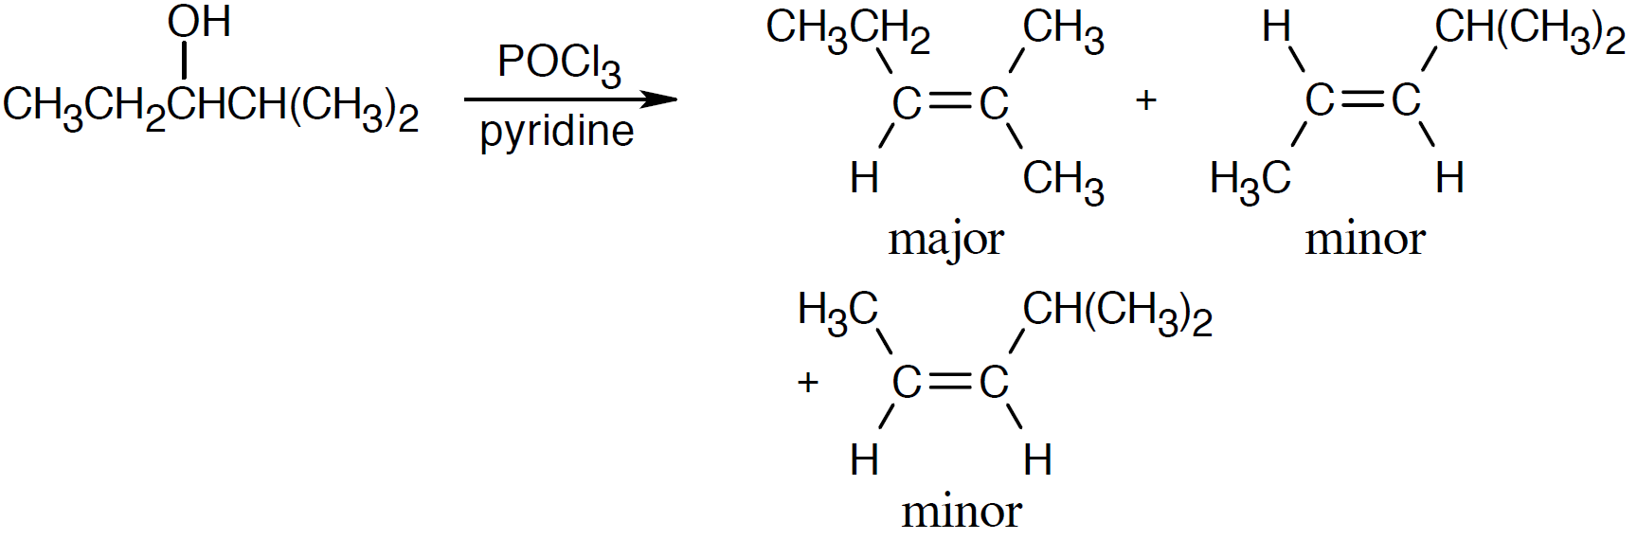
Worked Example
b)
Notes:
Reactions of alcohols

Slide 51

Conversion of Alcohols into Esters
Reaction can be carried out in a single step with the use of a strong acid as catalyst
Reactivity of carboxylic acid is increased by converting it into a carboxylic acid chloride, which then reacts with the alcohol
Notes:
Reactions of alcohols

Slide 52

Oxidation of Alcohols
Accomplished by reagents, such as KMnO₄, CrO₃, and Na₂Cr₂O₇
Notes:
Oxidation of alcohols

Slide 53

Oxidation of Alcohols
Primary alcohols are oxidized to either aldehydes or carboxylic acids
To prepare aldehyde from a primary alcohol, I(V)-containing Dess–Martin periodinane in dichloromethane is used
Notes:
Oxidation of alcohols

Slide 54

Oxidation of Alcohols
Secondary alcohols oxidize easily to give ketones
Effective with inexpensive reagents such as Na₂Cr₂O₇ in acetic acid
Notes:
Oxidation of alcohols

Slide 55

Oxidation of Alcohols
Cr(VI) reagent reacts with the alcohol to give a chromate intermediate followed by expulsion of a reduced Cr(IV) species
Notes:
Oxidation of alcohols

Slide 56

Worked Example
What products are expected from oxidation of the following compounds with CrO₃ in aqueous acid?
With the Dess–Martin periodinane?
a) 1-Hexanol
b) 2-Hexanol
Solution:
Notes:
Oxidation of alcohols

Slide 57

Protection of Alcohols
Done to overcome incompatibility that might arise by protecting the interfering functional group
Involves:
Introduction of a protecting group to block interfering function
Execution of the desired reaction
Removal of the protecting group
Notes:
Protection of alcohols

Slide 58

Protection of Alcohols
Reaction with chlorotrimethylsilane in the presence of base yields an unreactive trialkylsilyl ether
Notes:
Protection of alcohols

Slide 59

Figure 17.9 - Use of a TMS-Protected Alcohol During a Grignard Reaction
Notes:
Protection of alcohols

Slide 60

Worked Example
TMS ethers can be removed by treatment with fluoride ion as well as by acid catalyzed hydrolysis
Propose a mechanism for the reaction of cyclohexyl TMS ether with LiF
Fluorotrimethylsilane is a product
Solution:
Reaction is S_{N}2 reaction
Nucleophile displaces an alkoxide ion
Notes:
Protection of alcohols

Slide 61

Phenols and Their Uses
Phenols are synthesized using isopropylbenzene, commonly called cumene
Process yields two valuable chemicals at the same time
Notes:
Phenols and their uses

Slide 62

Figure 17.10 - Mechanism
Notes:
Phenols and their uses

Slide 63

Figure 17.10 - Mechanism
Notes:
Phenols and their uses

Slide 64

Worked Example
Show the mechanism for the reaction of p-methylphenol with 2-methylpropene and H₃PO₄ catalyst to yield the food additive BHT
Solution:
Phosphoric acid protonates 2-methylpropene, forming a tert-butyl carbocation
Notes:
Phenols and their uses

Slide 65


Worked Example
Alkylation occurs ortho to the –OH group for both steric and electronic reasons
Second tert-butyl carbocation alkylation forms BHT
Notes:
Phenols and their uses

Slide 66
Reactions of Phenols
Electrophilic aromatic substitution reactions
Hydroxyl group is a strongly activating substituent in electrophilic aromatic substitution reactions
Makes phenols substrates for:
Electrophilic halogenation
Nitration
Sulfonation
Friedel-Crafts reactions
Notes:
Reactions of phenols

Slide 67

Reactions of Phenols
Oxidation of phenols
Oxidation of a phenol yields a 2,5-cyclohexadiene-1,4-dione, or quinone
Fremy's salt [(KSO₃)₂NO] is used in more complex cases
Quinones can be easily reduced to hydroquinones by reagents such as NaBH4 and SnCl2
Notes:
Reactions of phenols

Slide 68

Reactions of Phenols
Ubiquinones mediate electron-transfer processes involved in energy production
Also called coenzymes Q
Are components of the cells in all aerobic organisms
Notes:
Reactions of phenols

Slide 69
Spectroscopy of Alcohols and Phenols
Infrared spectroscopy
Alcohols have a strong C–O stretching absorption near 1050 cm⁻¹
Characteristic O–H stretching absorption occurs at 3300 to 3600 cm⁻¹
Exact position of the O–H stretch depends on the extent of hydrogen-bonding in the molecule
Notes:
Spectroscopy of alcohols and phenols

Slide 70

Figure 17.11 - IR spectrum of Cyclohexanol
Notes:
Spectroscopy of alcohols and phenols

Slide 71

Worked Example
Assume that you need to prepare 5-cholesten-3-one from cholesterol
How could IR spectroscopy be used to tell whether the reaction was successful?
What differences would you look for in the IR spectra of starting material and product?
Notes:
Spectroscopy of alcohols and phenols

Slide 72
Worked Example
Solution:
Infrared spectra of cholesterol and 5-cholestene-3-one exhibit a unique absorption
Cholesterol shows an –OH stretch at 3300–3600cm⁻¹
5-cholestene-3-one shows a C=O stretch at 1715 cm⁻¹
In the oxidation of cholesterol to 5-cholestene-3-one, the –OH band disappears and is replaced by a C=O band
No –OH absorption should be visible on complete oxidation
Notes:
Spectroscopy of alcohols and phenols

Slide 73
Spectroscopy of Alcohols and Phenols
Nuclear magnetic resonance spectroscopy
Alcohol carbon absorptions fall in the range 50-80δ
Alcohols also show characteristic absorptions in the ¹H NMR spectrum
Electron-withdrawing effect of the nearby oxygen absorbs at the range of 3.4 to 4.5 δ
Spin-spin splitting is not often observed between O–H proton and neighboring protons on C
The O–H proton is rapidly exchanged for deuterium and the hydroxyl absorption disappears from the spectrum, on adding D₂O to an NMR
Notes:
Spectroscopy of alcohols and phenols

Slide 74

Figure 17.13 - ¹H NMR Spectrum of 1-Propanol
Notes:
Spectroscopy of alcohols and phenols

Slide 75
Worked Example
When the 1H NMR spectrum of an alcohol is run in dimethyl sulfoxide solvent rather than in chloroform, exchange of the O–H proton is slow and spin–spin splitting is seen between the O–H proton and C–H protons on the adjacent carbon What spin multiplicities are expected for the hydroxyl protons in the following alcohols?
a) 2-Methyl-2-propanol
b) Cyclohexanol
Notes:
Spectroscopy of alcohols and phenols

Slide 76
Worked Example
Solution:
Under conditions of slow exchange, the –OH signal of a tertiary alcohol (R₃COH) is unsplit
The signal of a secondary alcohol (R₂CHOH) is split into a doublet
The signal of a primary alcohol (RCH₂OH) is split into a triplet
a) 2-Methyl-2-propanol is a tertiary alcohol; its –OH signal is unsplit
b) Cyclohexanol is a secondary alcohol; its –OH absorption is a doublet
Notes:
Spectroscopy of alcohols and phenols

Slide 77


Spectroscopy of Alcohols and Phenols
Mass spectrometry
Alcohols undergo alpha cleavage, a C–C bond nearest the hydroxyl group is broken, yielding a neutral radical plus a charged oxygen-containing fragment
Radical cation alcohols undergo dehydration to yield an alkene radical anion
Notes:
Spectroscopy of alcohols and phenols

Slide 78

Figure 17.14 - Mass spectrum of 1-butanol ( M¹= 74)
Notes:
Spectroscopy of alcohols and phenols

Slide 79
Summary
Alcohols are among the most versatile of all organic compounds, occur widely in nature, and are important industrially
Functional groups are protected because Grignard reagents can’t be prepared from alkyl halides that contain reactive functional groups in the same molecule
Phenols are aromatic counterparts of alcohols but are more acidic
Phenols can be oxidized to quinones, and quinones can be reduced back to hydroquinones

